Slide 1
PLANT-O-METER
by GROUP 16

Slide 2

What is this project?
This project is a machine that measures the components which is essential for plant and seed growth.

Slide 3
Essentials for plant growth
The essentials for plant growth are;
Light density
Temperature
Soil moisture
CO2 amount in the air
Minerals in the soil

Slide 4
Essentials for plant growth -Light density
The light density suitable for plant photosynthesis is generally 10000-30000 Lux.
Adjusting light density is crucial in different growing periods for plants. In most situations, sunlight is uncontrollable because of weather changes.

Slide 5
Essentials for plant growth -Temperature
The optimum temperature for germination is from 25 to 35℃. But the highest temperature should not exceed 45℃. The higher the temperature is high, the faster the germination. The suitable growth temperature is;
10-15℃ for the seedling stage;
18-30℃ for the rapid growth period (19-25℃ are the most suitable);
18-20℃ for flowering and fruiting.
The seed can survive at 3-5℃ and lower temperature within 10-15 days after germination. When the temperature gets down to -5℃, the growth of seeds will be delayed.

Slide 6
Essentials for plant growth -Soil moisture
During the germination period or the first six weeks of growth period, you should keep the soil with enough moisture.
When it comes to the rapid growth period (crop height increases by 4-6cm/day), the soil moisture should be 70%-80% of that in the field soil. At this water level, the plant's growth is in the best condition.

Slide 7
Essentials for plant growth -CO2 amount in the air
For most cultivated plants, you get higher returns to carbon dioxide concentration up to around 1000 ppm, and between 1000ppm and 1800ppm
Most plants reach a limit after which cellular processes that transport carbon dioxide are disrupted and photosynthesis rate actually decreases.
Thereafter (above 1800 ppm, or 1.8%) all supplemental carbon dioxide is actually harmful to growth, as it becomes toxic to the plant and induces things like developmental malformation and leaf necrosis.

Slide 8
Why we chose to do this project?
Due to the economical crisis going on in Turkey, we thought it would be a great idea to support the farmer ecosystem in this circumstances since they are being affected from this crisis the most.
We decided to go on with this project since its equivalents are much more expensive then how much it cost for us to do.
But the final decision came from the thought about helping the Earth to become greener again because with the help of this project we can see the exact amounts and with that, we can create ideal circumstances for each plant to grow.

Slide 9
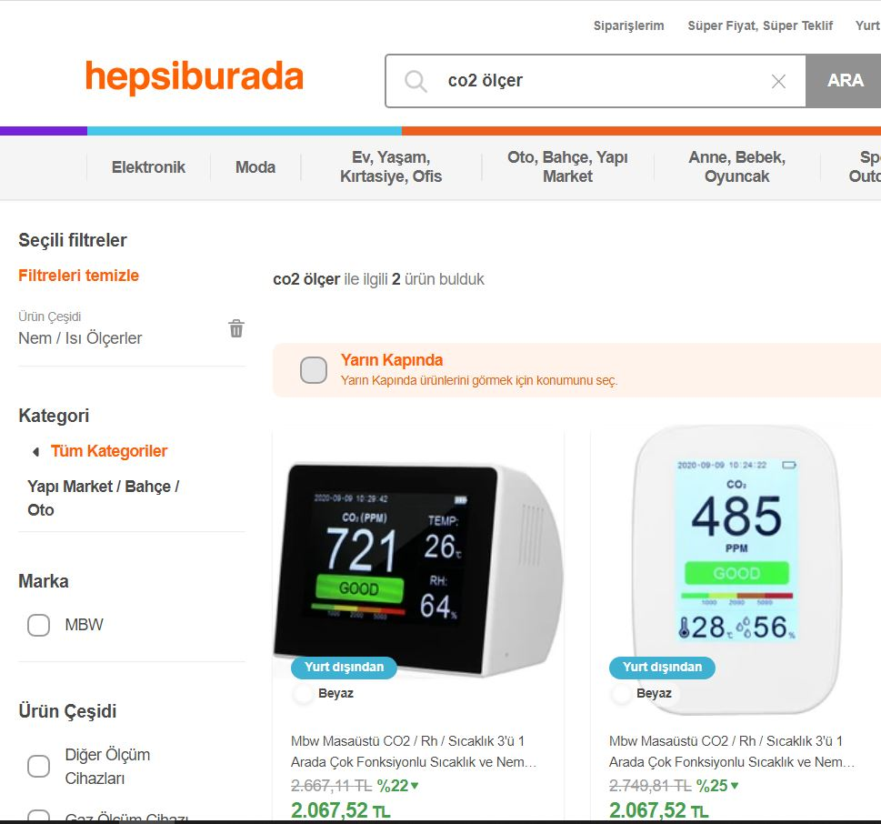
Price comparasion between this project and top Turkish online shopping sites
Name | Price
Arduino UNO set | 90₺
LM35 temperature sensor | 20₺
LDR light sensor | 2₺
Humidity sensor | 16₺
LCD panel | 20₺
10k potentiometer | 3₺
MQ135 gas sensor | 30₺
TOTAL: | 191₺
Plant-o-Meter
Hepsiburada

Slide 10

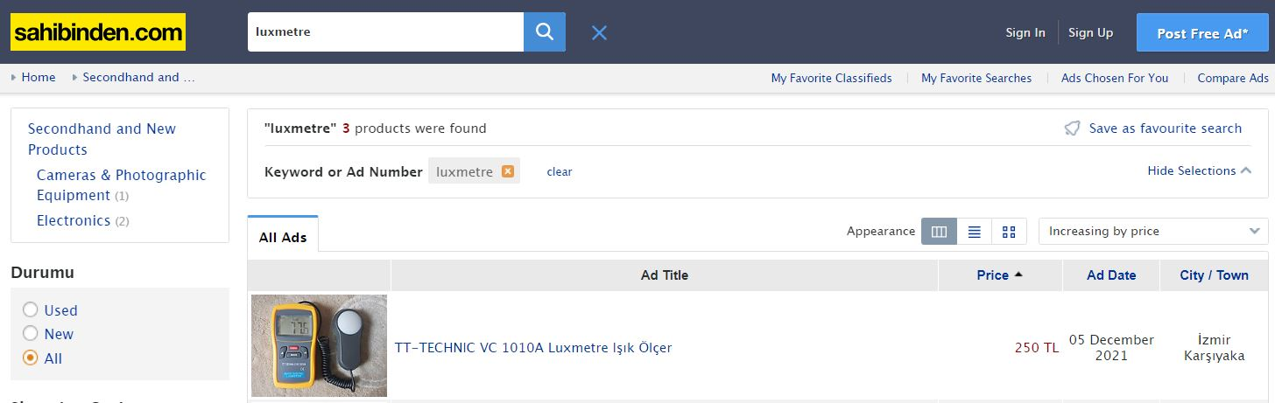
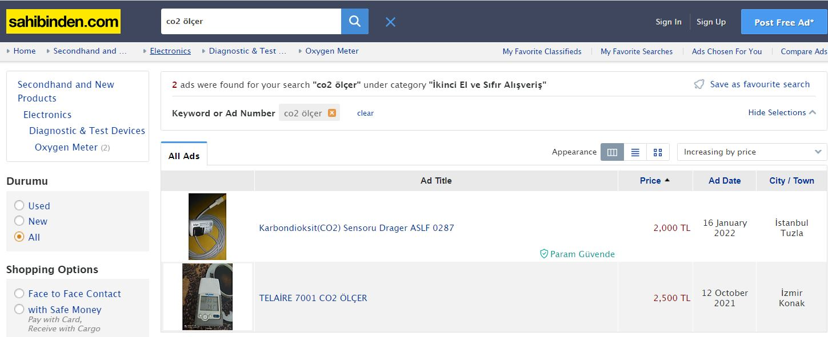
Price comparasion between this project and top Turkish online shopping sites
sahibinden.com

Slide 11
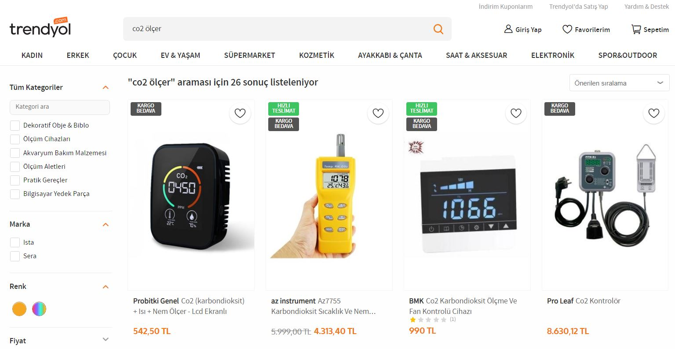
Price comparasion between this project and top Turkish online shopping sites
Trendyol

Slide 12
How can this project be improved to the next level?
As you saw before, this project is NOT measuring every essential. With the lack of experience and knowledge comes from becoming a computer engineer student just over 5 months ago, we cannot be able to find a way to measure the minerals in the soil. But with experienced people have enough knowledge and ideal circumstances, this project can reach its final form and we also can reach our ultimate goal: a greener Earth.

Slide 13

I sincerely appreciate you for listening and hopefully supporting our project and our goals on behalf of my dear group.
THE PRESENTATION HAS ENDED

